Slide 1
Chapter 5
Interprocess Communication
1

Slide 2
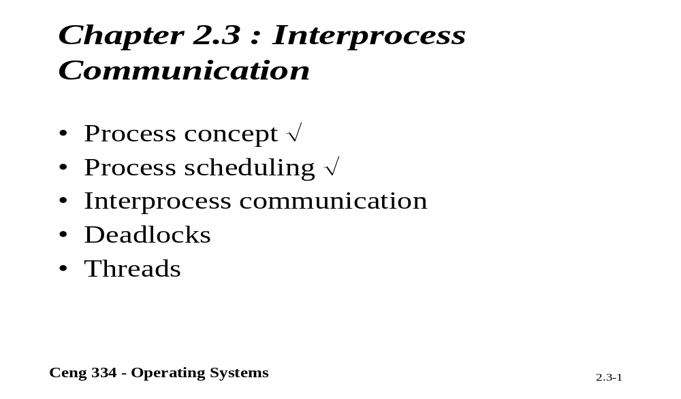
Chapter 2.3: Interprocess Communication

Slide 3
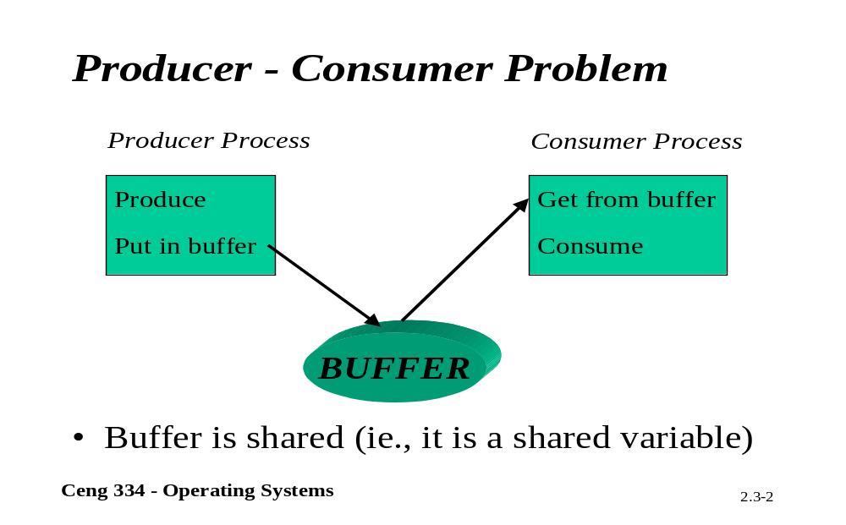
Producer Consomer Problem

Slide 4
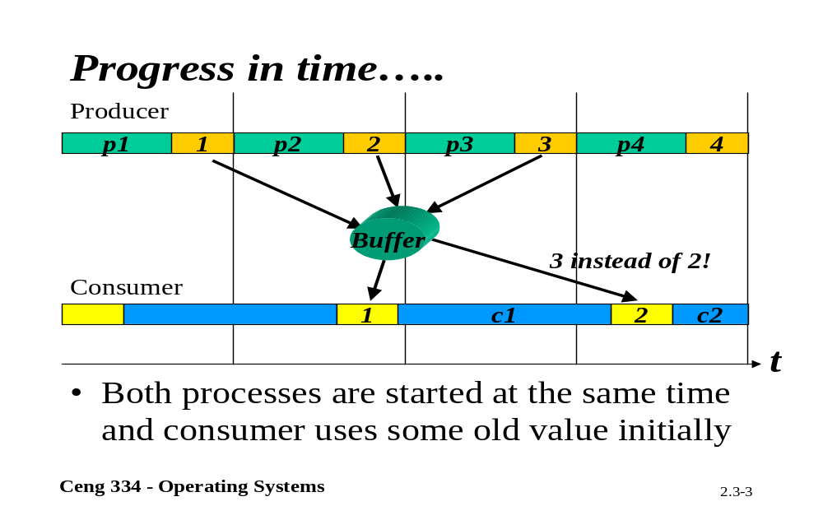
Progressing time

Slide 5

Interprocess Communication
Race Conditions
Two processes want to access shared memory at same time

Slide 6
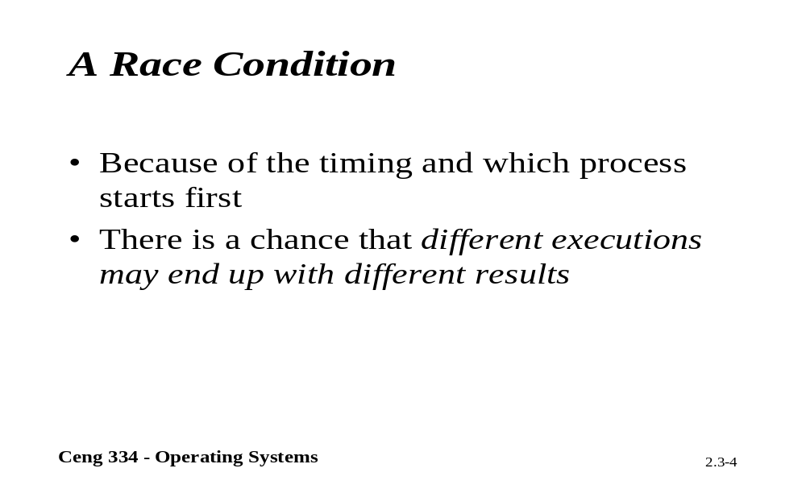
A Race Condition

Slide 7
Critical Regions (1)
Four conditions to provide mutual exclusion
No two processes simultaneously in critical region
No assumptions made about speeds or numbers of CPUs
No process running outside its critical region may block another process
No process must wait forever to enter its critical region

Slide 8
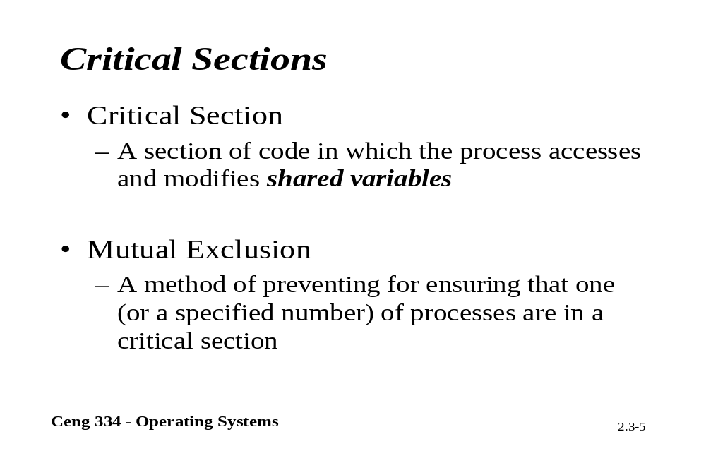
Critical Section

Slide 9

Critical Regions (2)
Mutual exclusion using critical regions

Slide 10
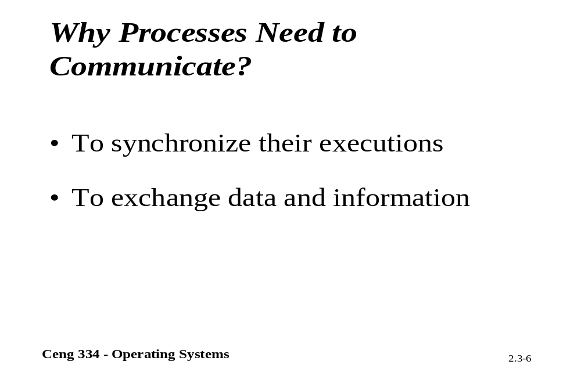
Why Interprocess Communication?

Slide 11
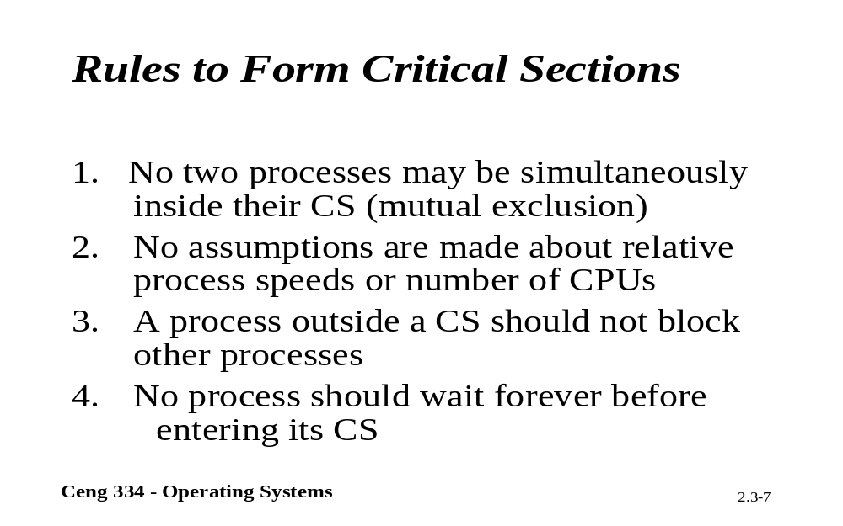
Rules to Interprocess Comm.

Slide 12
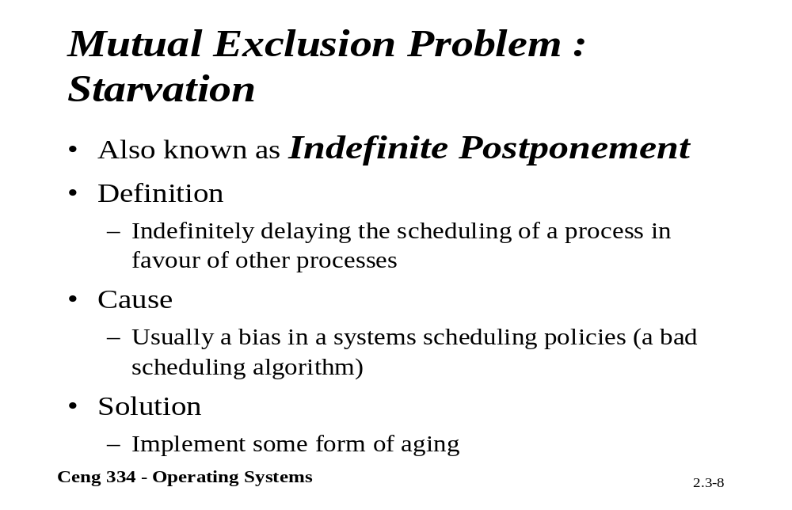
Starvation

Slide 13
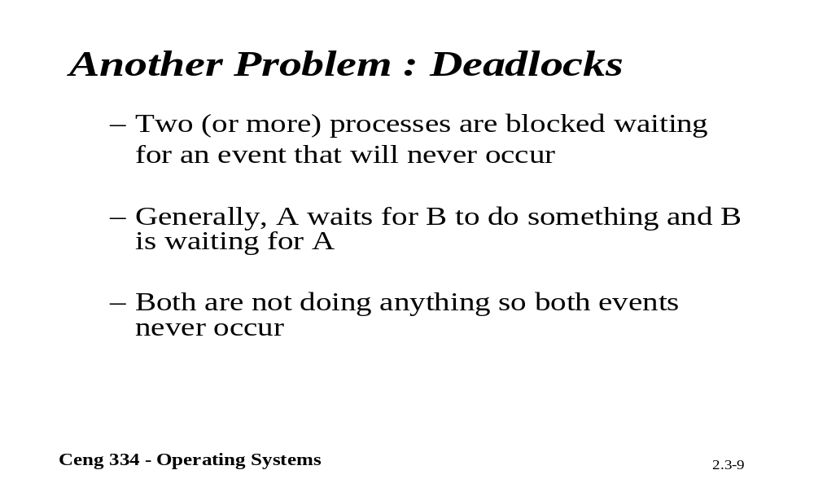
Deadlocks

Slide 14
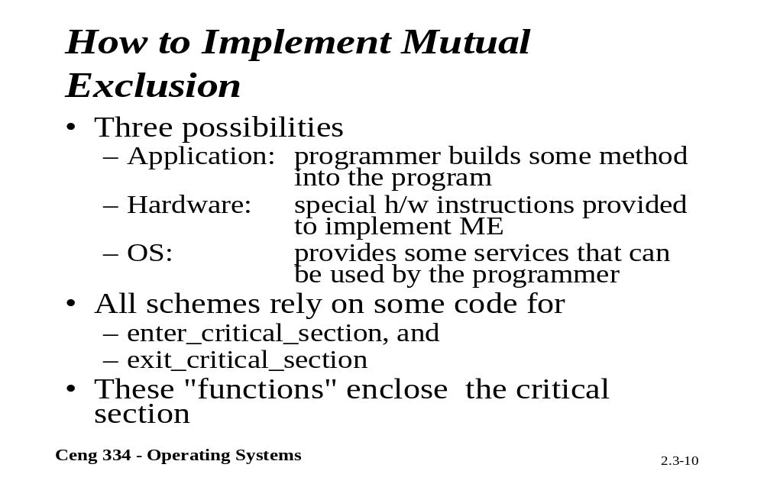
Implementig Mutual Exclusion

Slide 15
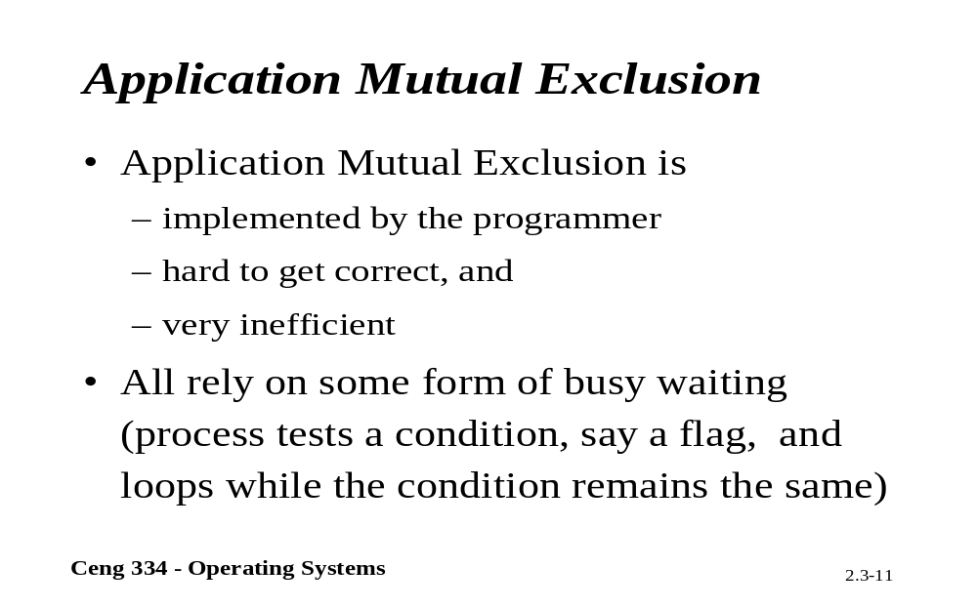
Application Mutual Exclusion

Slide 16
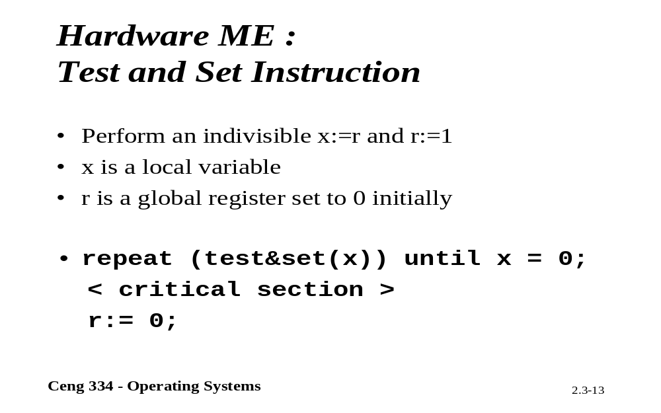
Test and Set

Slide 17
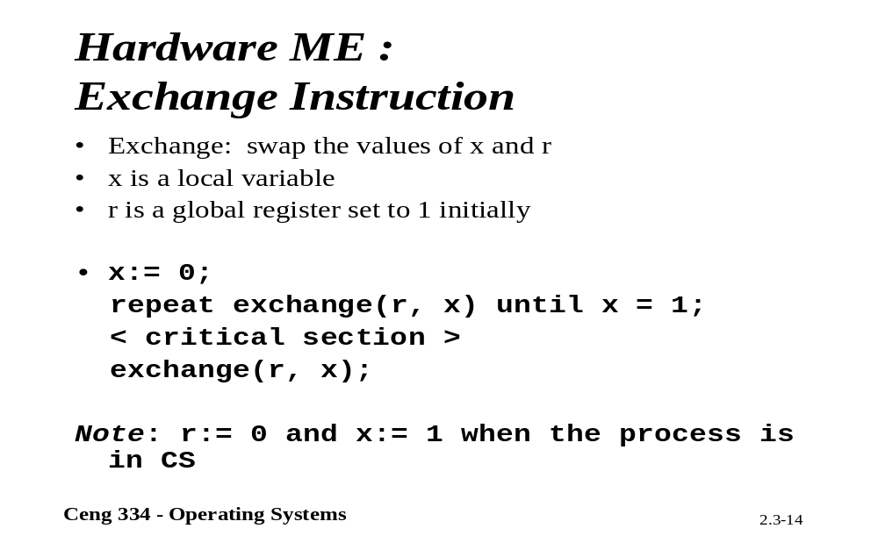
Harware Mutal Exculison

Slide 18
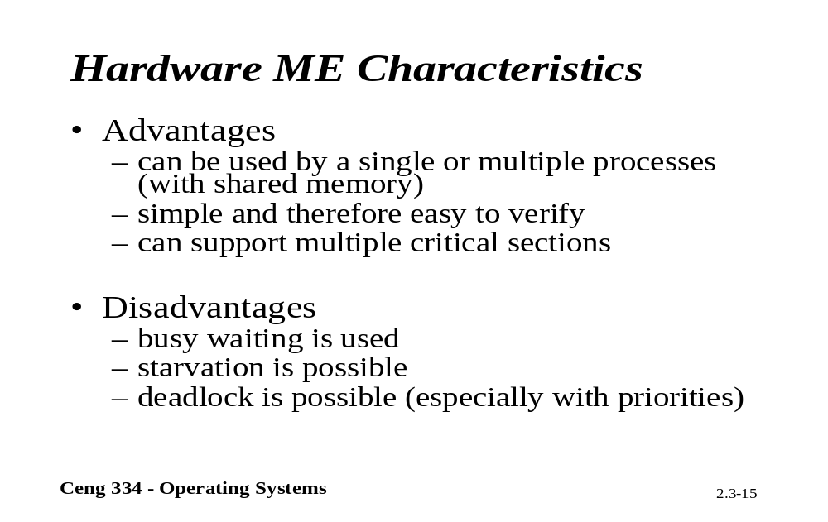
Characteristics

Slide 19
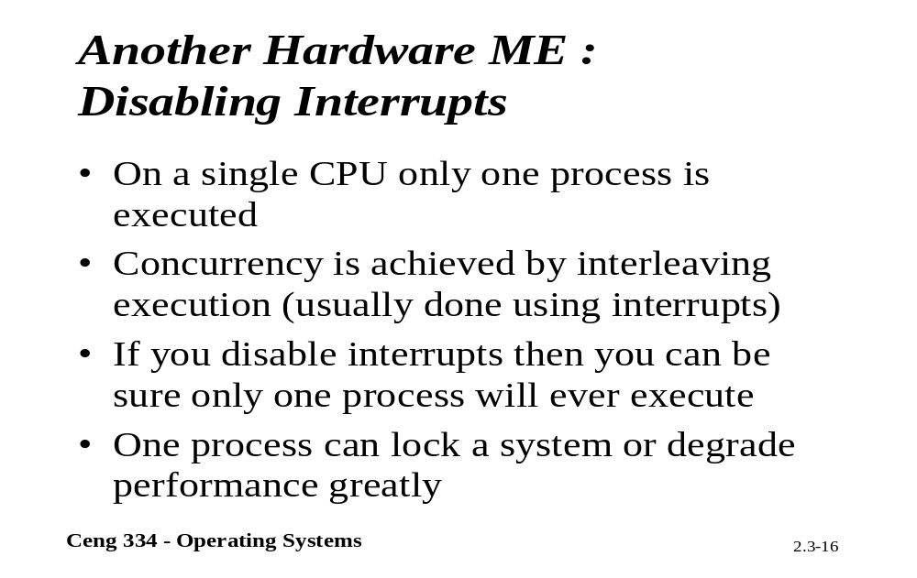
Disabling Interrups

Slide 20
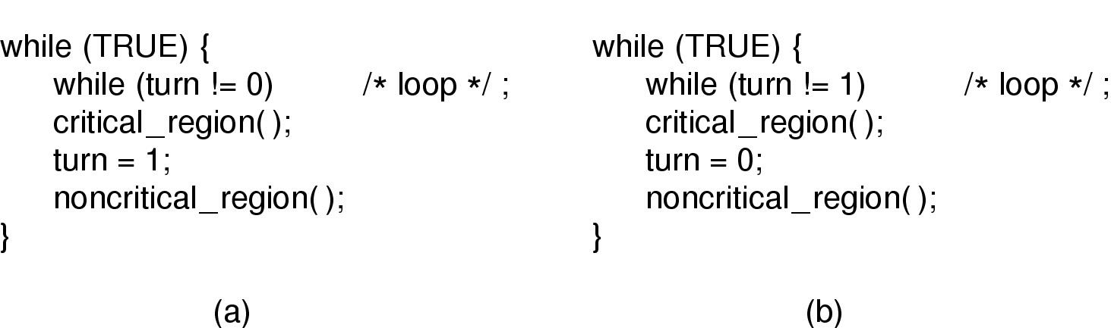
Mutual Exclusion with Busy Waiting (1)
Proposed solution to critical region problem
  (a) Process 0. (b) Process 1.

Slide 21
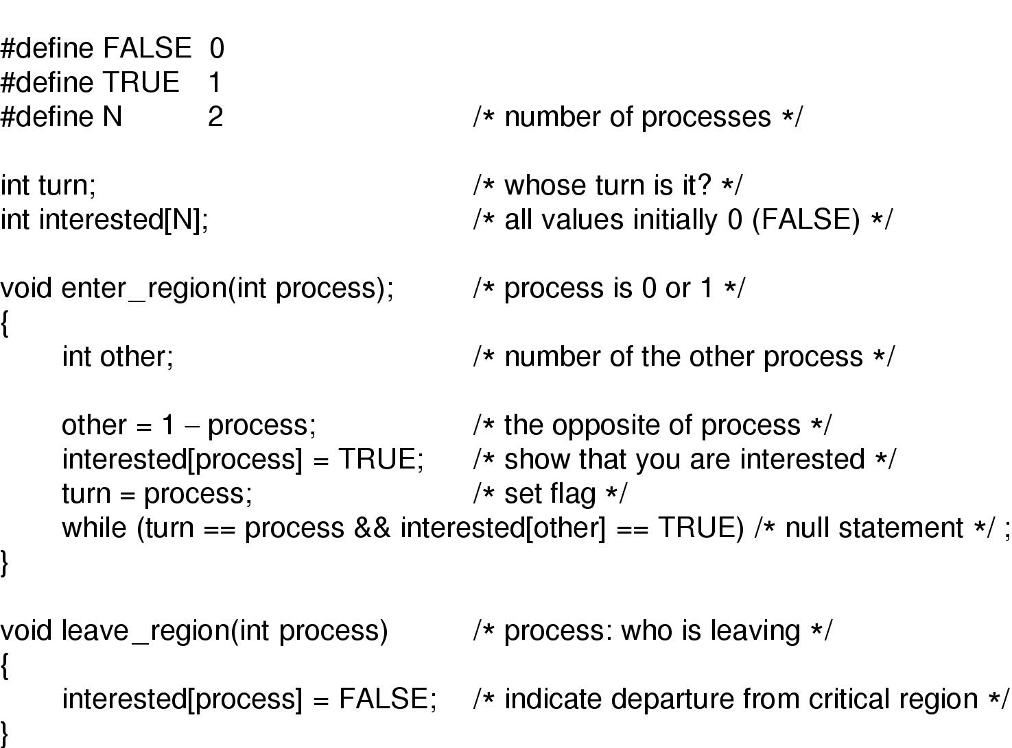
Mutual Exclusion with Busy Waiting (2)
Peterson's solution for achieving mutual exclusion

Slide 22
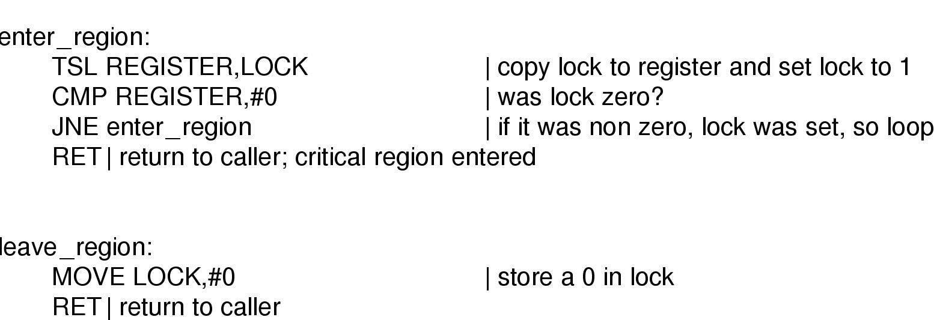
Mutual Exclusion with Busy Waiting (3)
Entering and leaving a critical region using the
TSL instruction

Slide 23
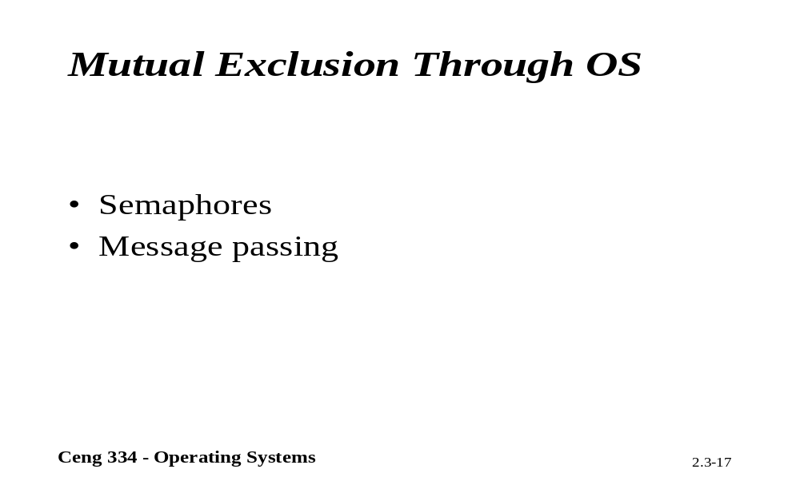
Mutual Exculusion Trough OS.

Slide 24
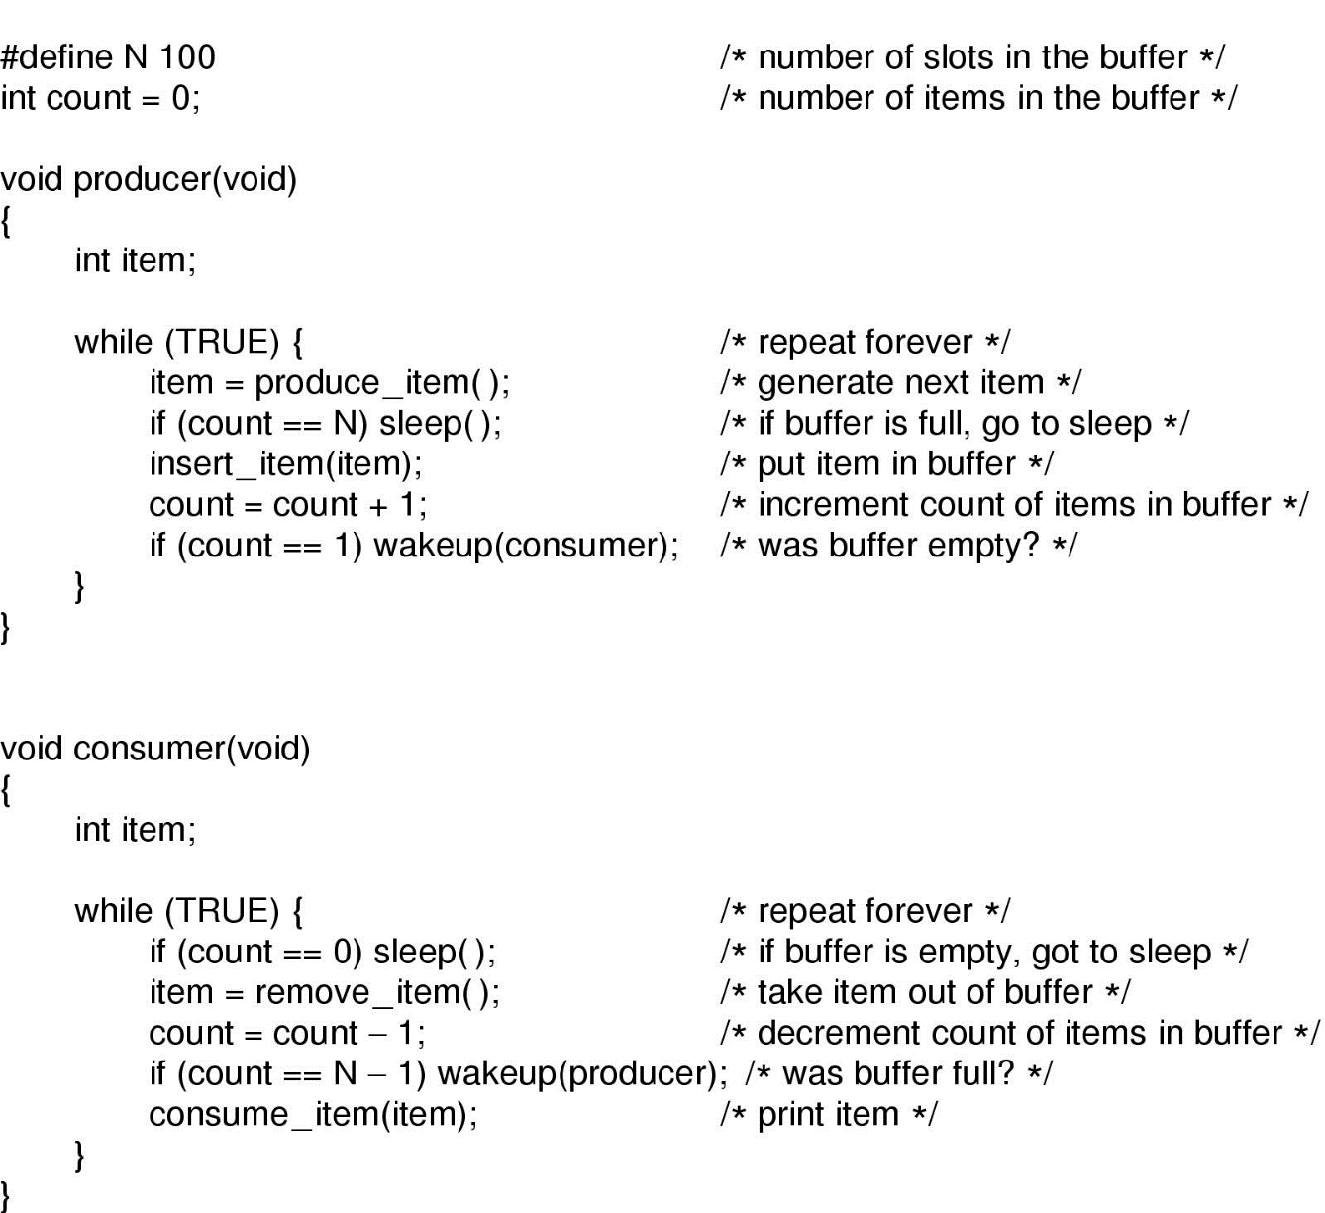
Sleep and Wakeup
Producer-consumer problem with fatal race condition

Slide 25
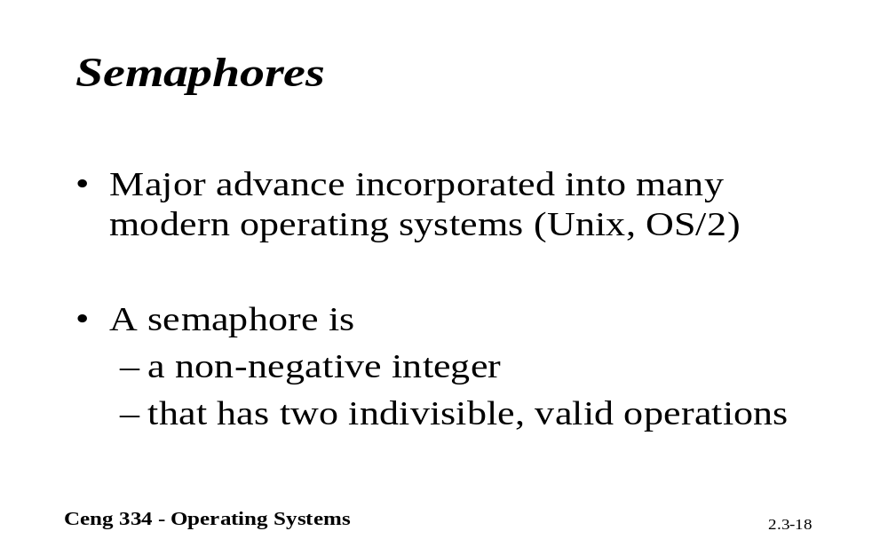
Semaphores

Slide 26
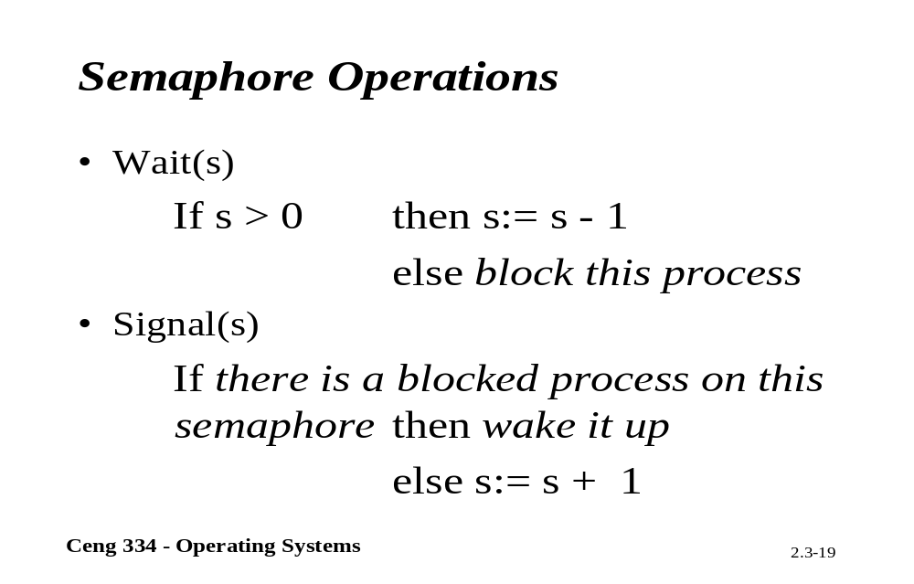
Semaphore Oparations

Slide 27
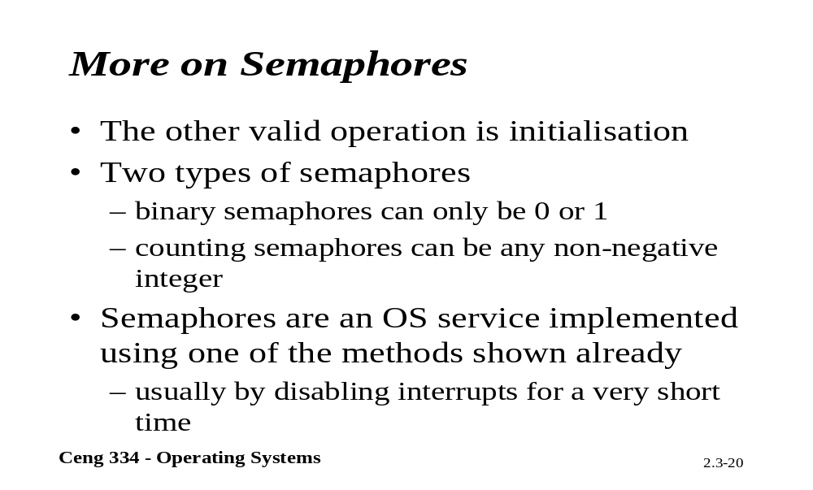
More on Semaphores

Slide 28
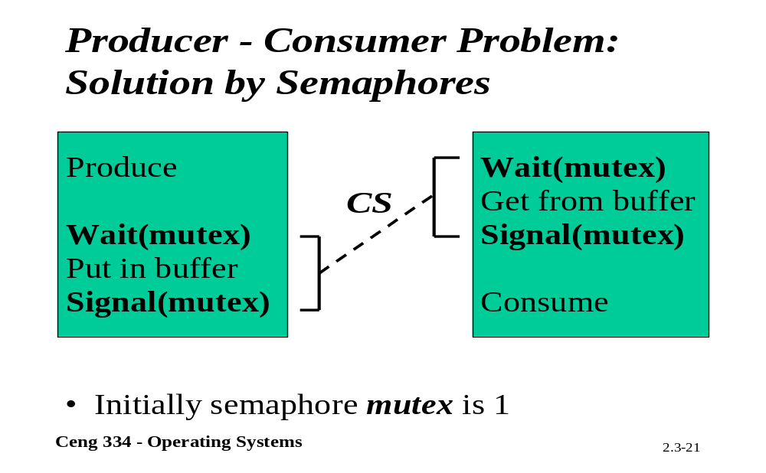
P-C Problem;Solution by Semephore

Slide 29
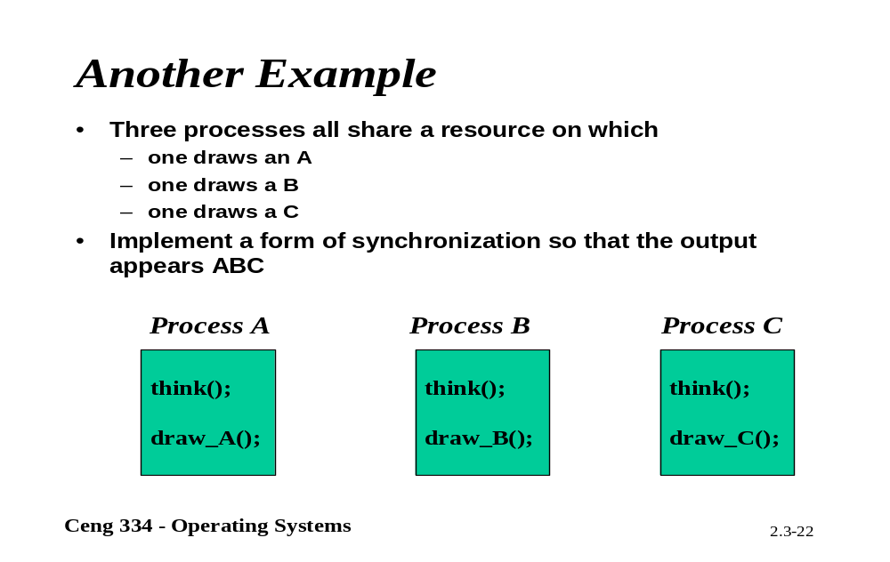
More Examples

Slide 30
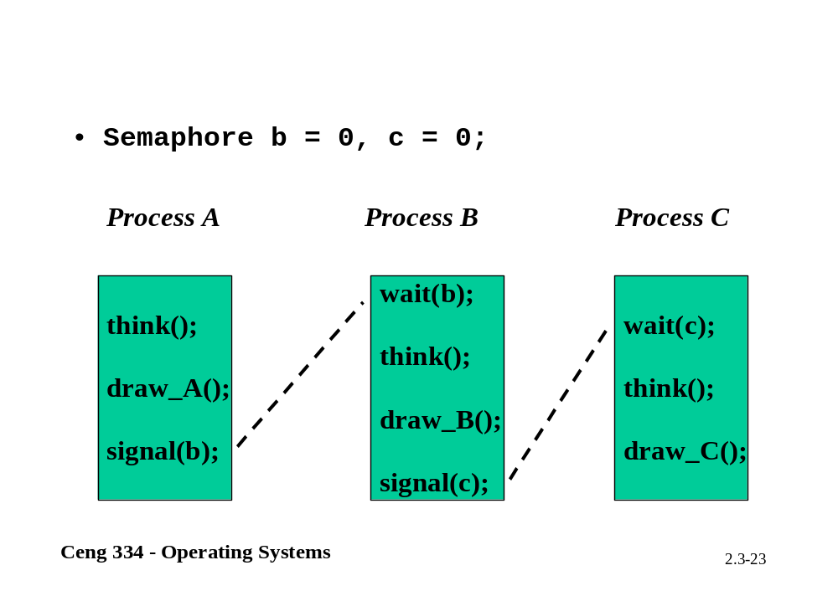

Slide 31
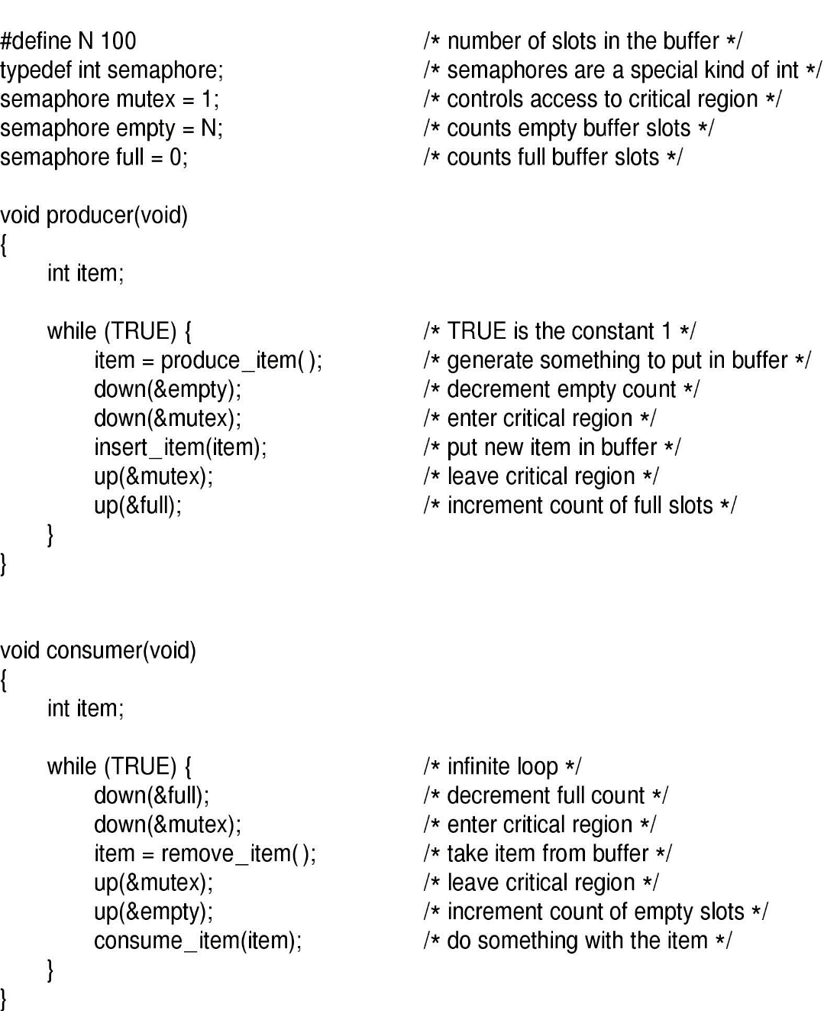
Semaphores
The producer-consumer problem using semaphores

Slide 32
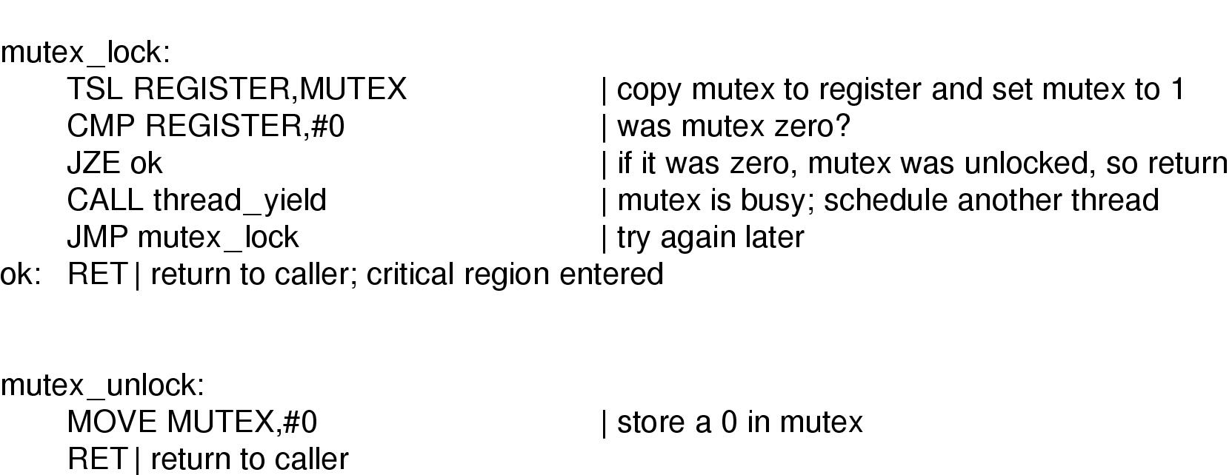
Mutexes
Implementation of mutex_lock and mutex_unlock

Slide 33
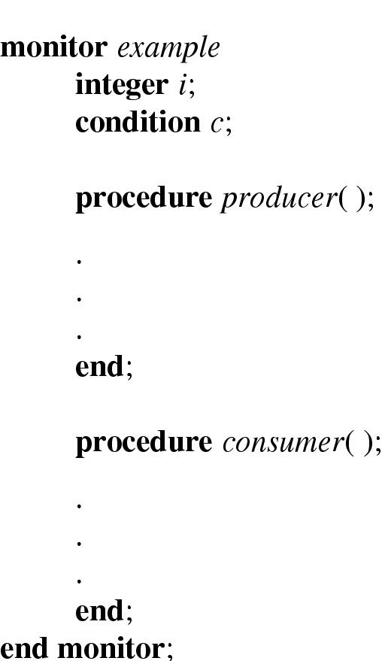
Monitors (1)
Example of a monitor

Slide 34
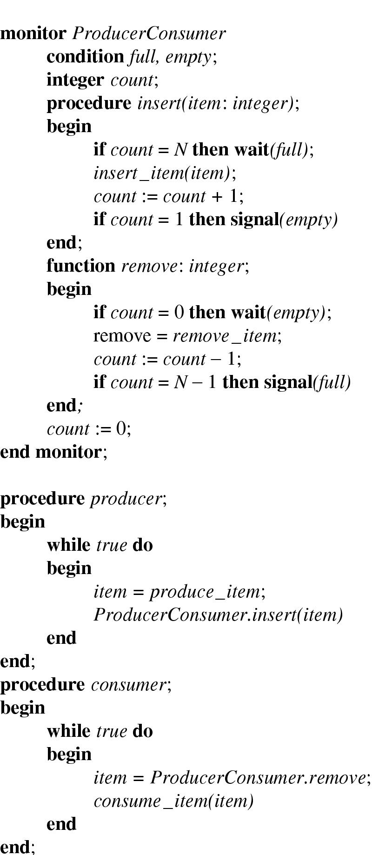
Monitors (2)
Outline of producer-consumer problem with monitors
  only one monitor procedure active at one time
  buffer has N slots

Slide 35
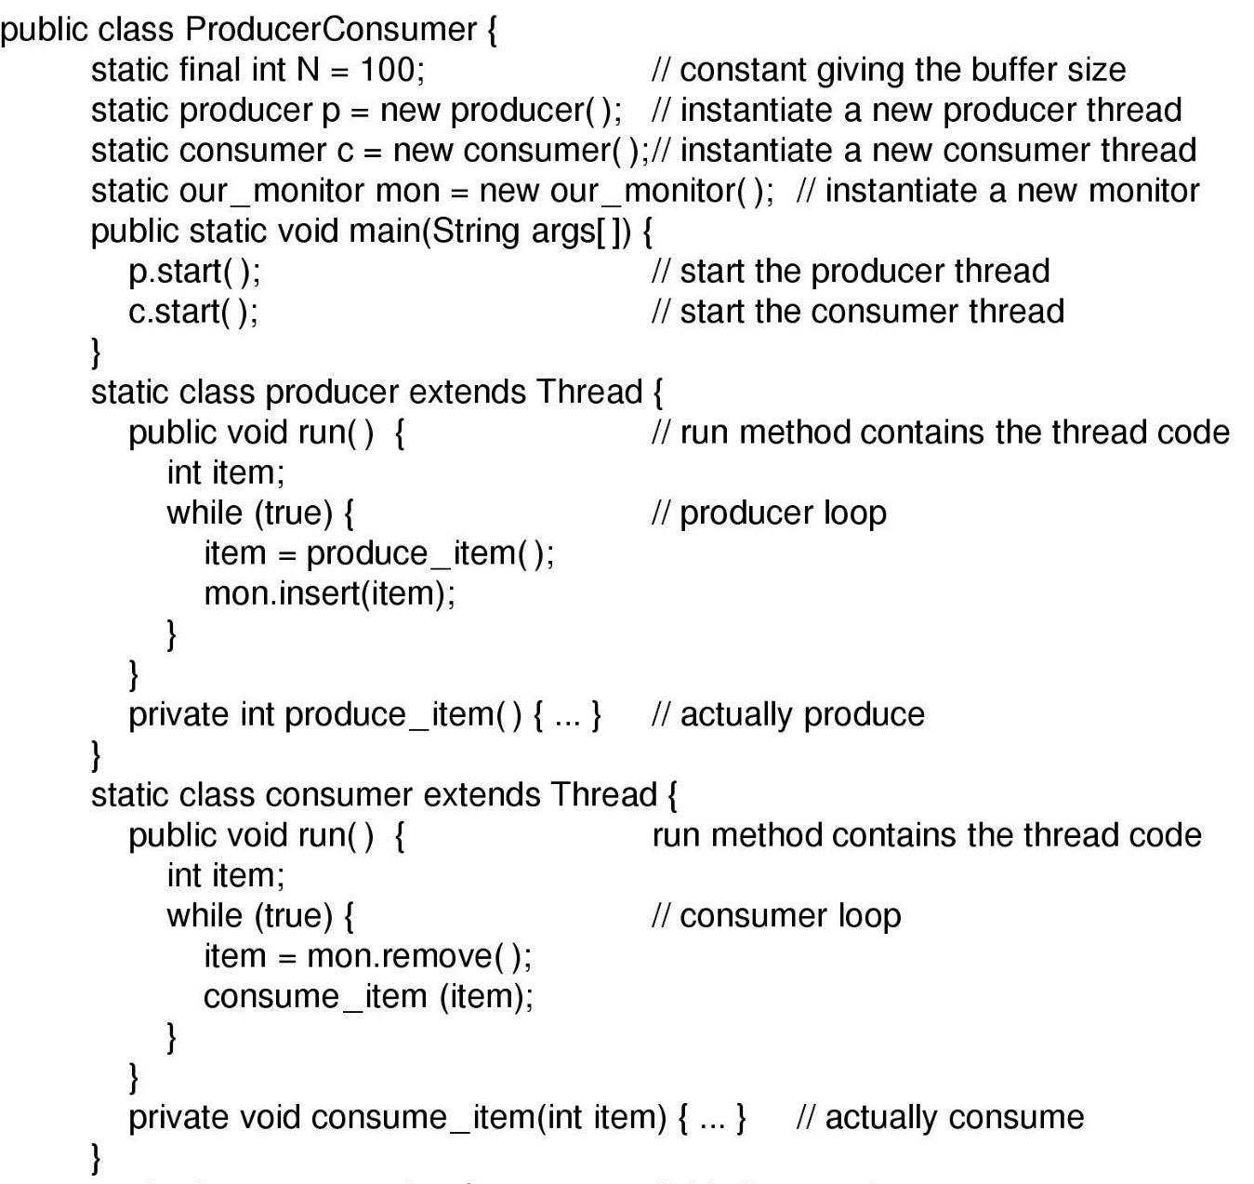
Monitors (3)
Solution to producer-consumer problem in Java (part 1)

Slide 36
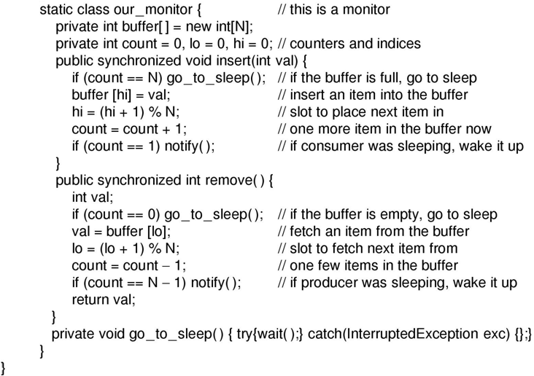
Monitors (4)
Solution to producer-consumer problem in Java (part 2)

Slide 37
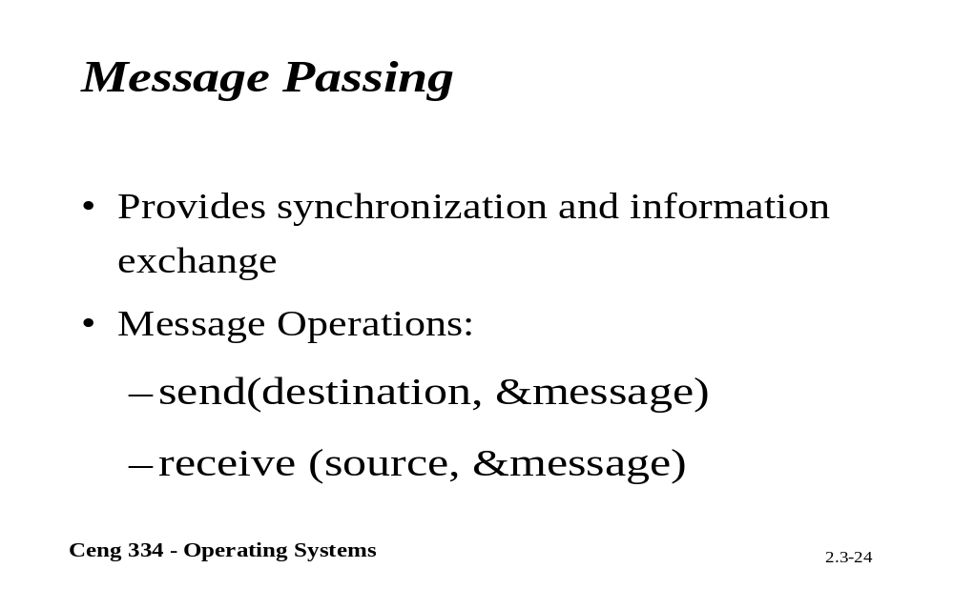
Message Passing

Slide 38
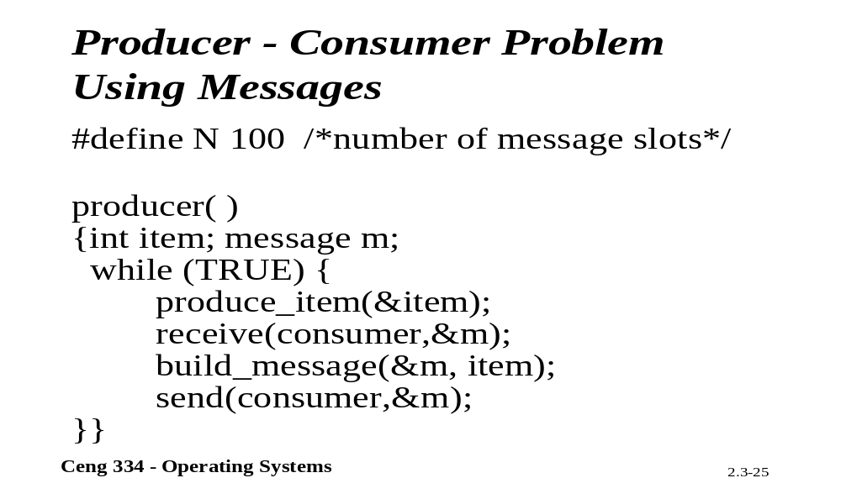
P-C Problem: Using Messages

Slide 39
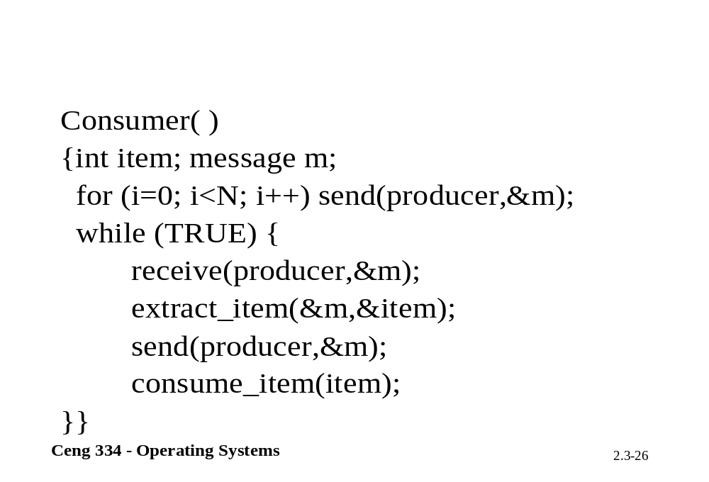

Slide 40
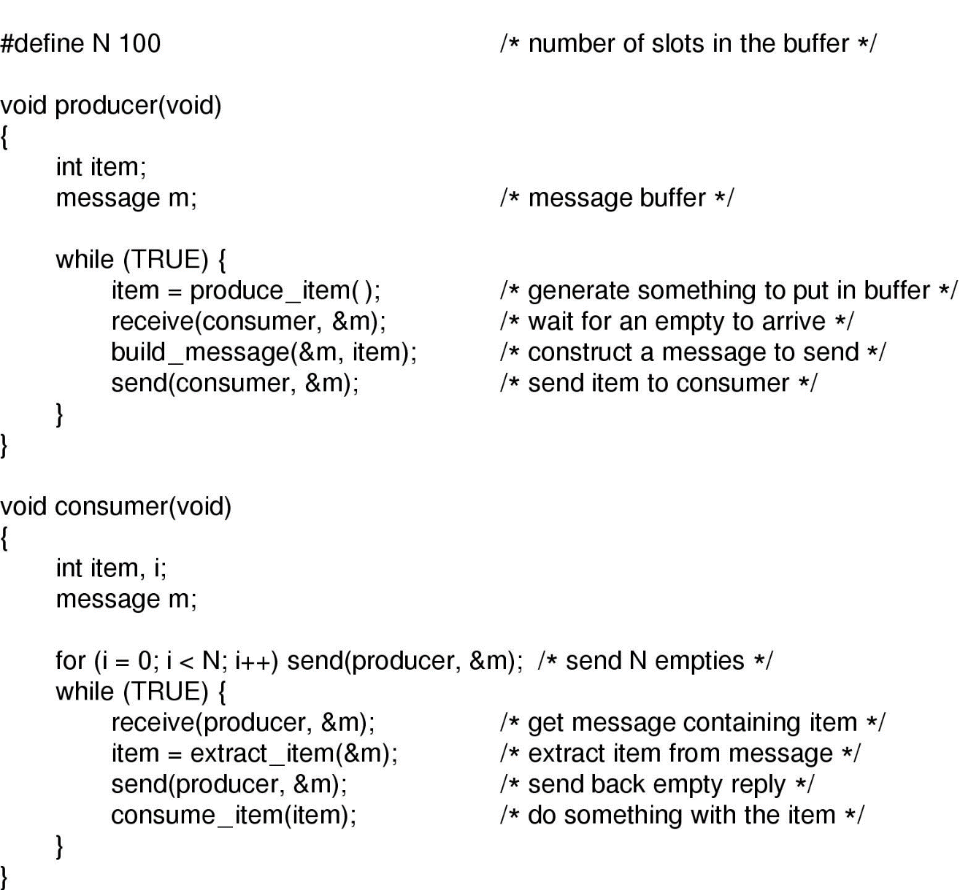
Message Passing
The producer-consumer problem with N messages

Slide 41
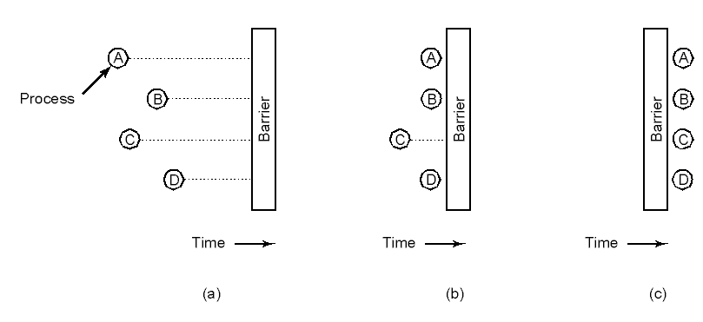
Barriers
Use of a barrier
  processes approaching a barrier
  all processes but one blocked at barrier
  last process arrives, all are let through

Slide 42

Dining Philosophers (1)
Philosophers eat/think
Eating needs 2 forks
Pick one fork at a time
How to prevent deadlock

Slide 43
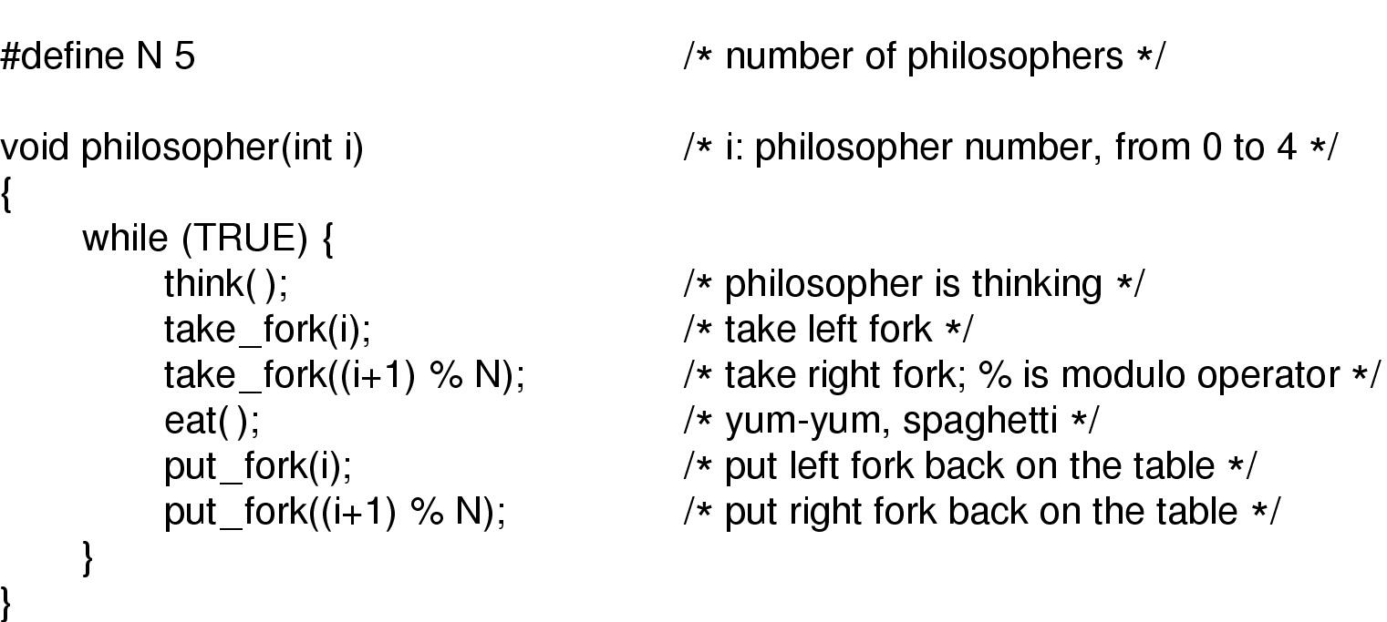
Dining Philosophers (2)
A nonsolution to the dining philosophers problem

Slide 44
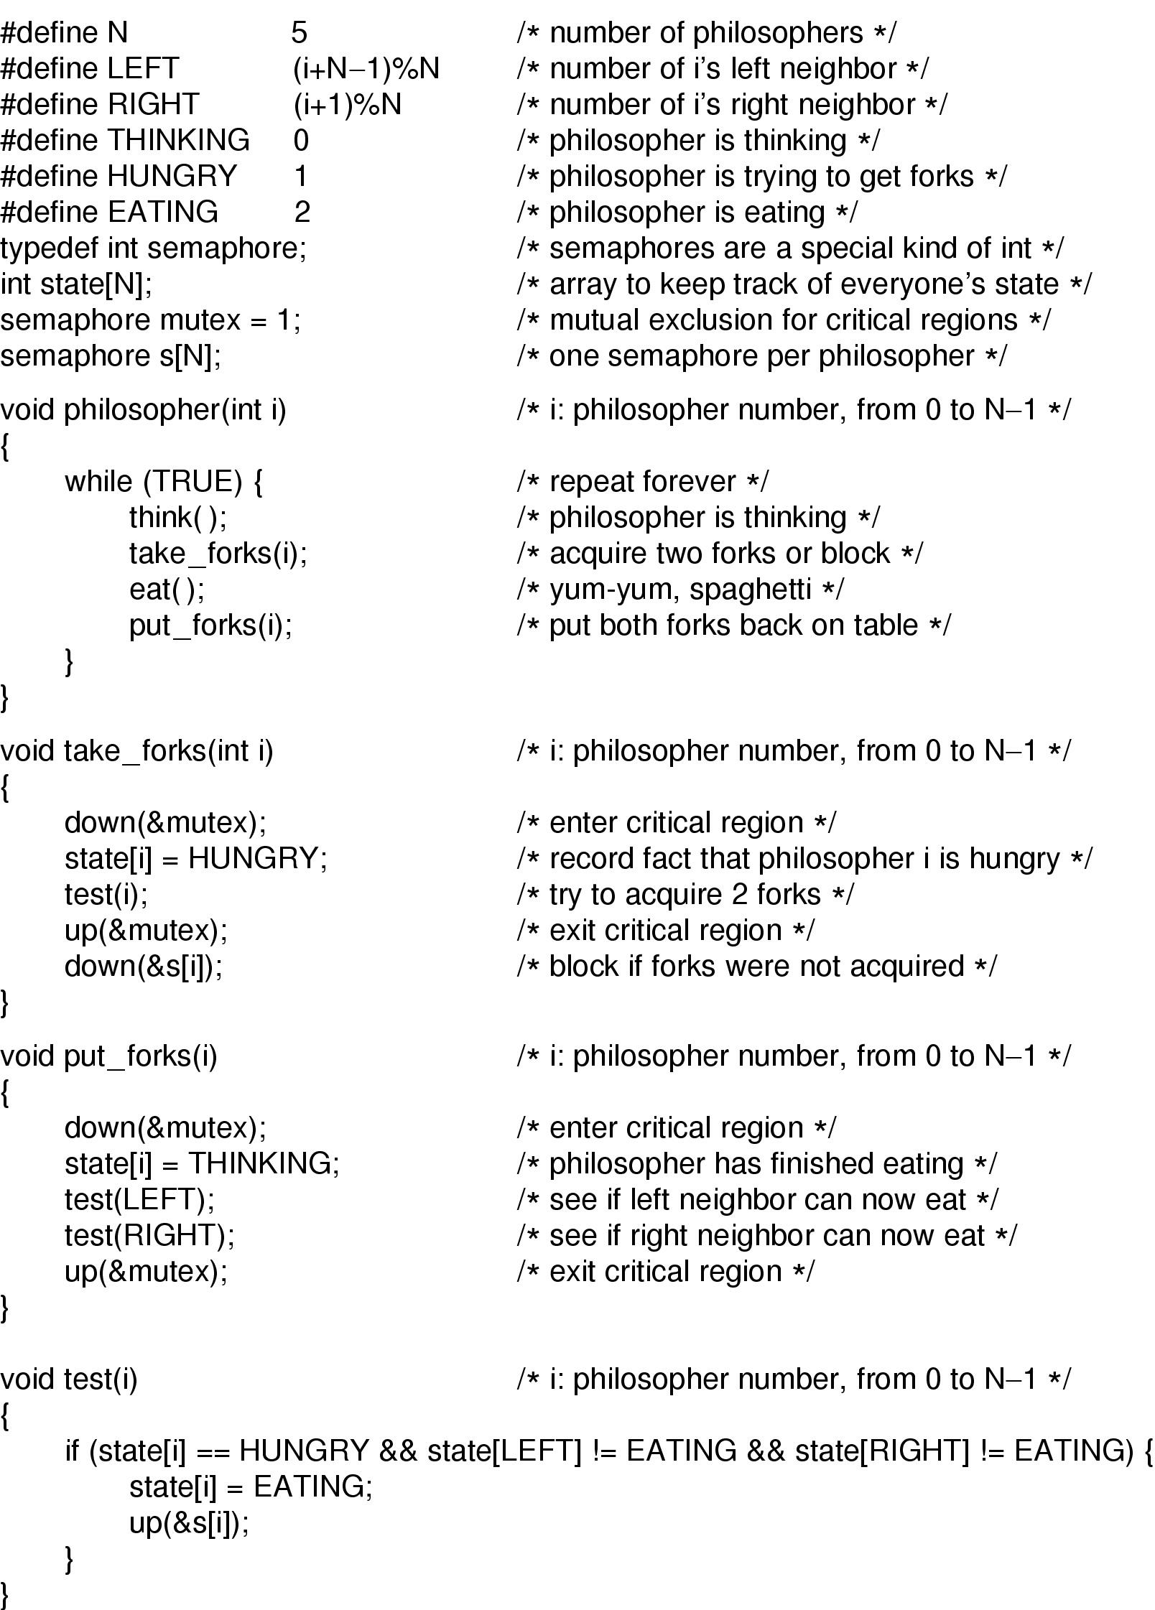
Dining Philosophers (3)
Solution to dining philosophers problem (part 1)

Slide 45
Dining Philosophers (4)
Solution to dining philosophers problem (part 2)

Slide 46
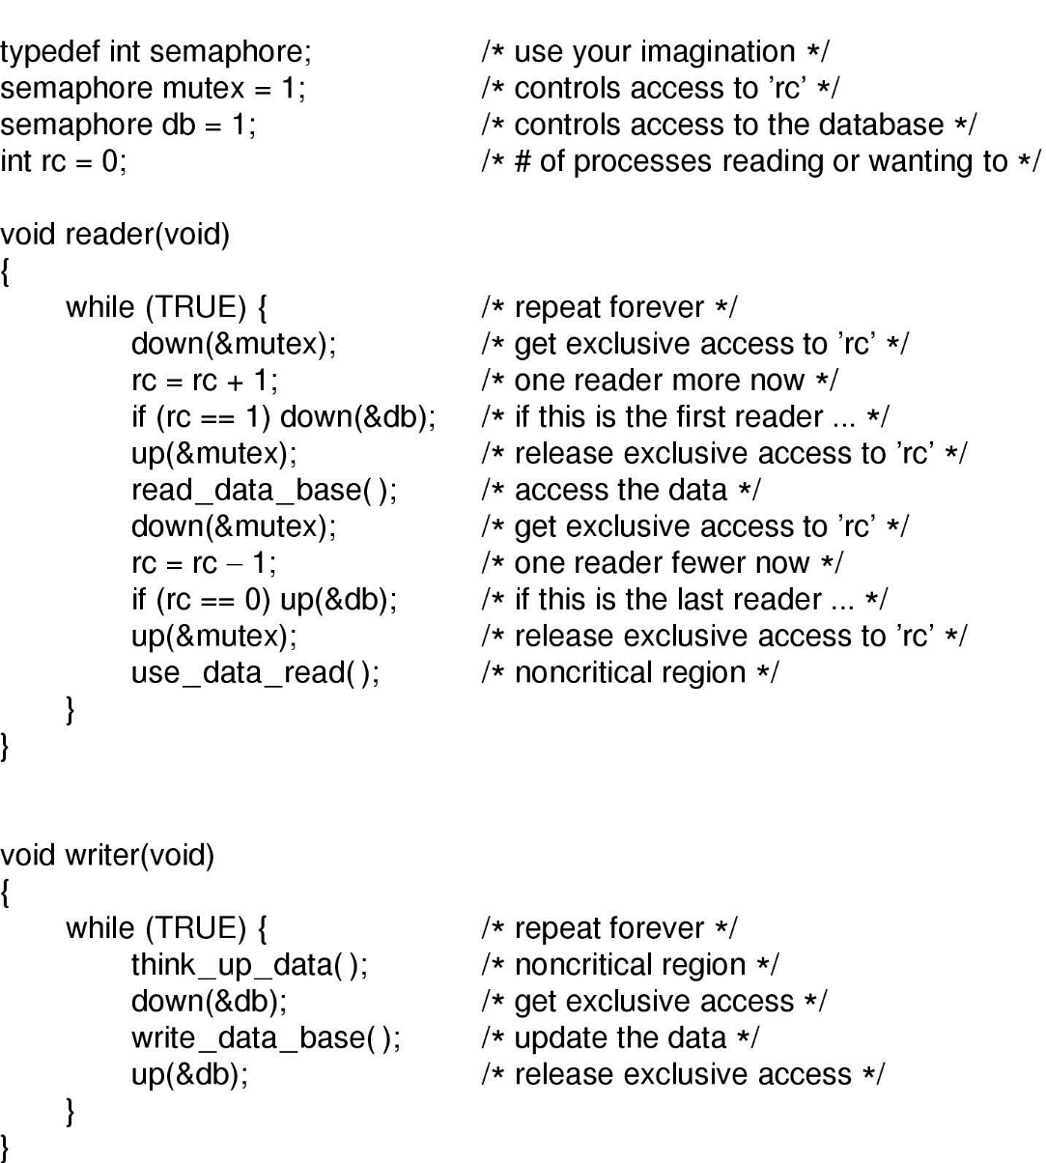
The Readers and Writers Problem
A solution to the readers and writers problem

Slide 47
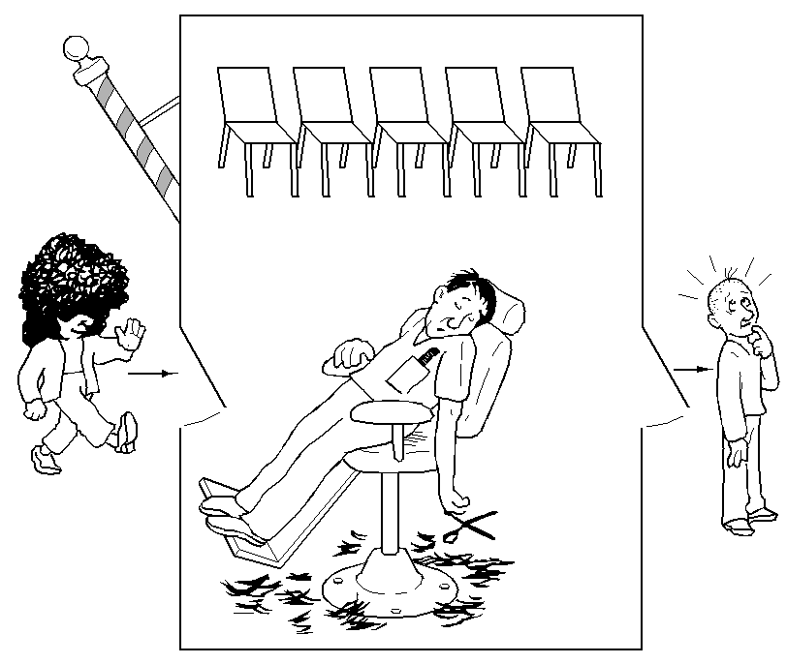
The Sleeping Barber Problem (1)

Slide 48
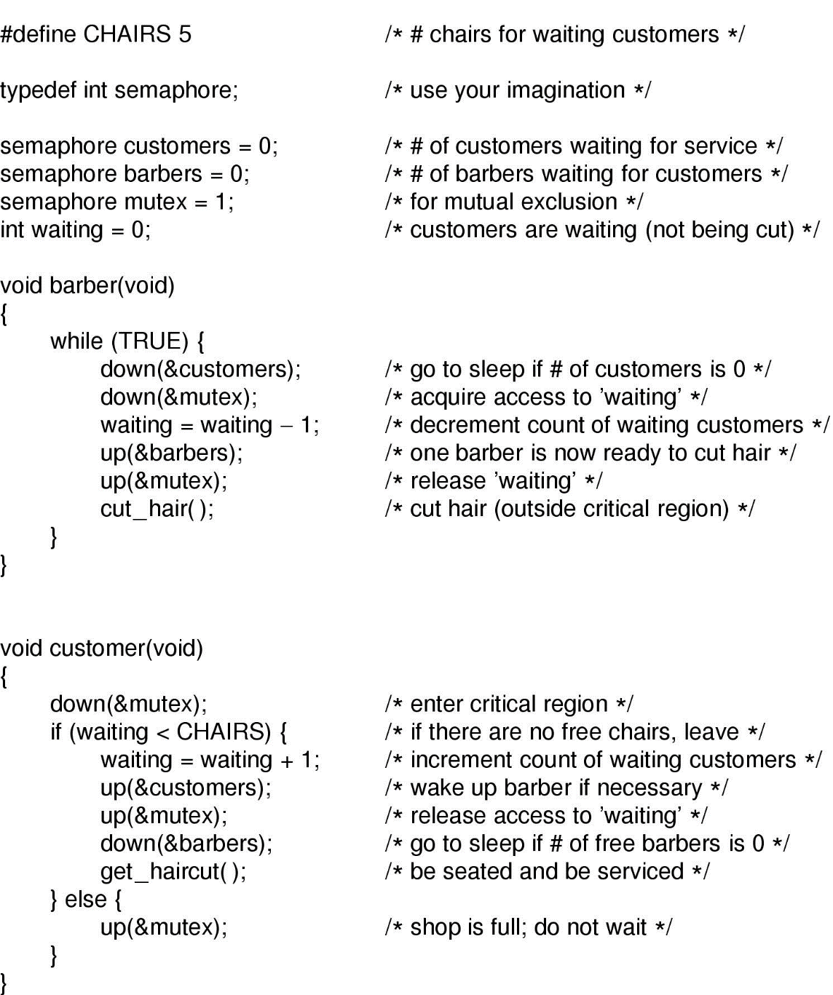
The Sleeping Barber Problem (2)
Solution to sleeping barber problem.

